Slide 1
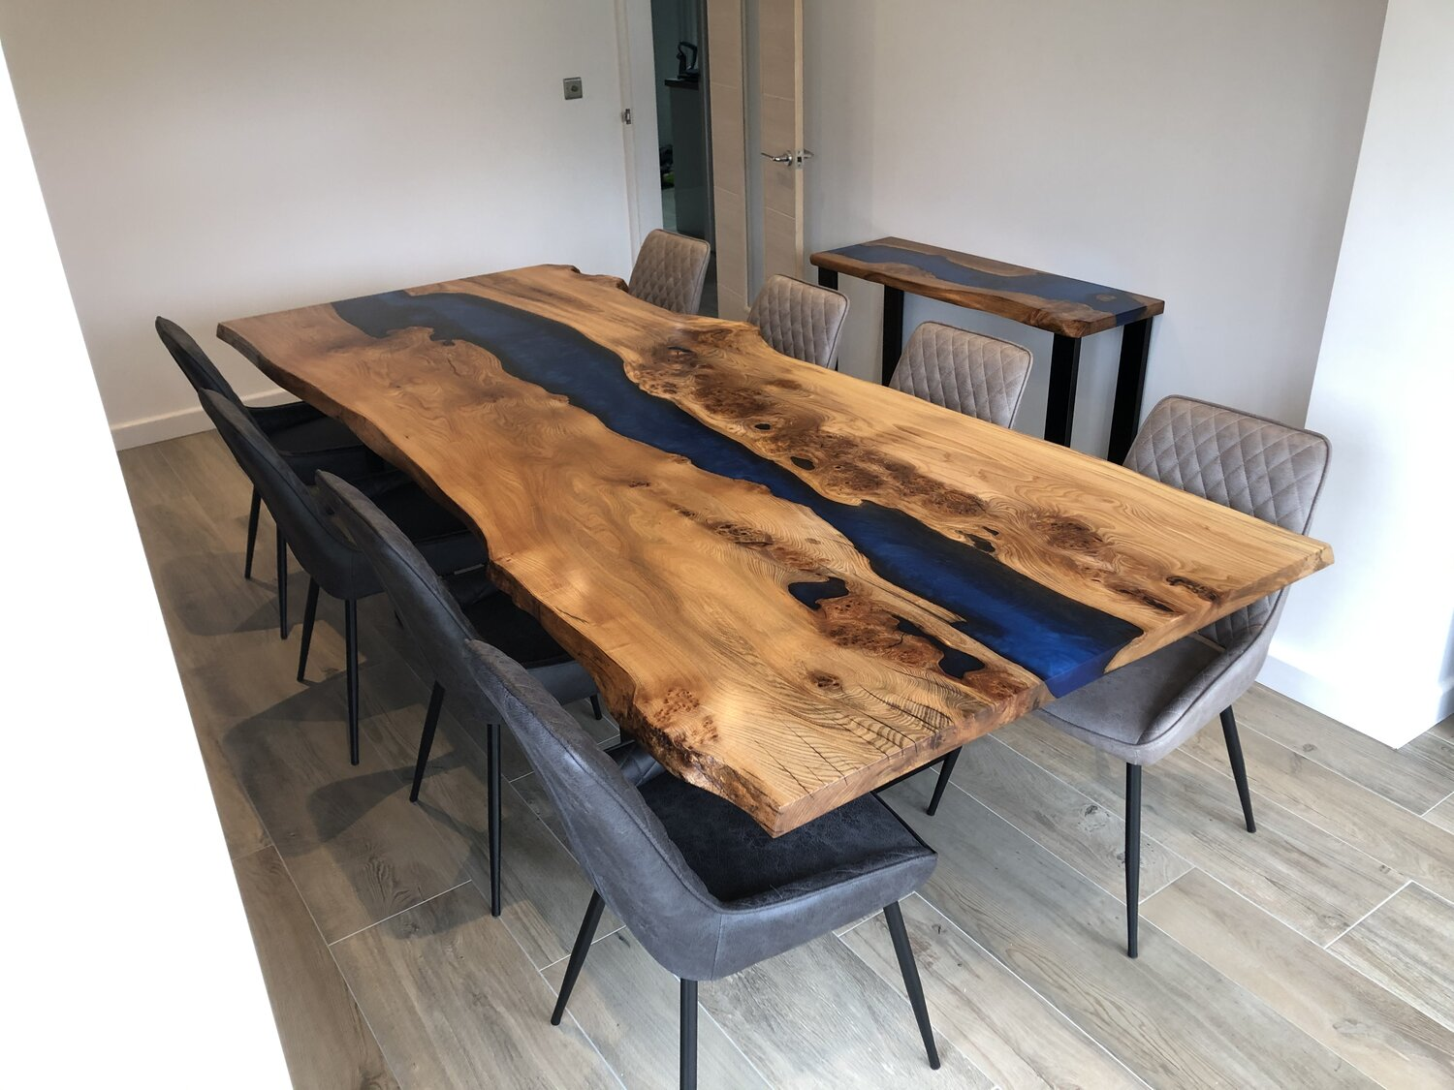
nat5 Design & Manufacture
Wood Manufacturing

Slide 2


Learning intentions & success criteria
Learning Intentions
Develop our understanding of woods, tools and manufacturing processes.
Success Criteria
I can name all the tools used in the wood workshop.
I can explain the different properties of wood.
I can name and explain the different manufacturing processes for wood.

Slide 3
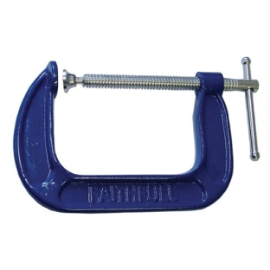
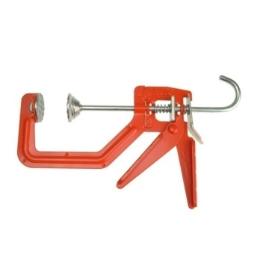
G-clamps
G-clamps are used to hold pieces of wood together, most often when gluing.
The screw section is tightened and the wood is sandwiched between the two flat pads with great pressure.
Care must be taken when clamping as some woods can be soft and become marked permanently with the pressure of the pads, this can be stopped be putting a larger piece of scrap wood between the clamp and your job.
They are named G-clamps because the shape of the clamp looks like the upper case letter “G”.

Slide 4
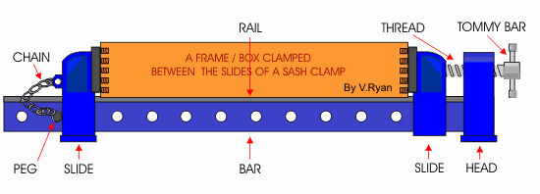
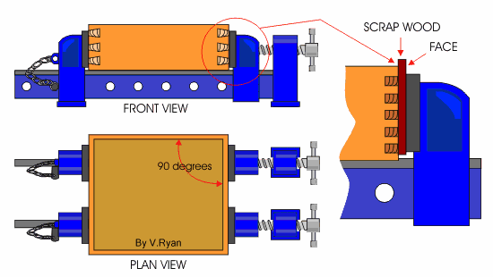
sash-cRamps
Sash Cramps are also used for holding pieces of wood together, usually whilst gluing.
They are used for bigger jobs due to the cramps being so long. They are normally used in pairs to hold together wooden frames or carcasses.
They work similarly to the G-clamps as they also sandwich the wood between it’s flat pads however the size of the cramp can be changed by sliding the back pad back and forth until the required size then locked into place, before tightening up the screw at the other end.

Slide 5
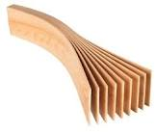
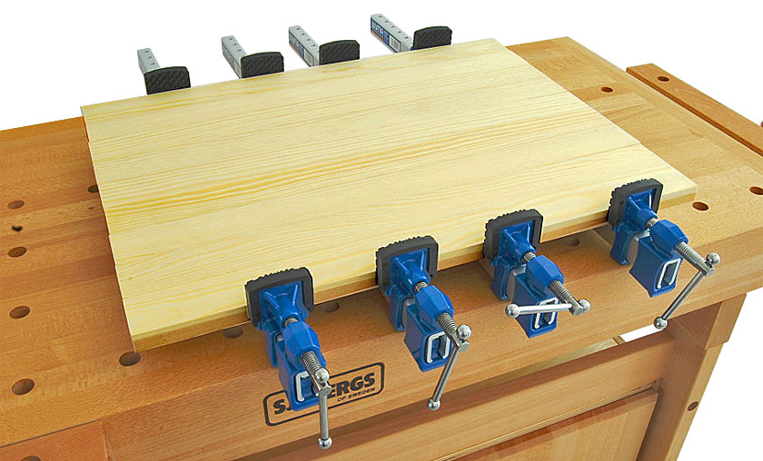
Laminating wood
Laminating is the process of gluing strips of wood together to form large sections.
Sash Cramps are also used for holding pieces of wood together.
Can be used for most natural timbers and some manmade board such as chipboard.
Allows for much larger timber sections to be created than grown naturally.
However, it is a time consuming process to manufacture

Slide 6
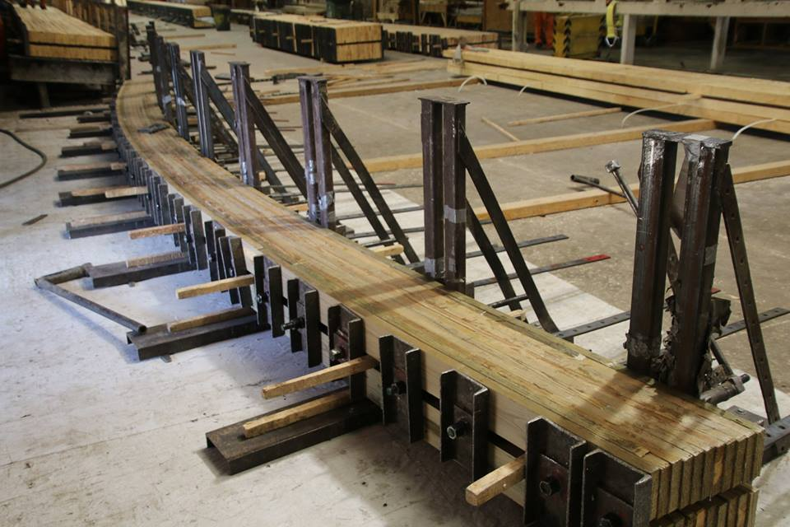
Many buildings now used laminated beams and trusses. These are complex to construct and require large warehouses and substantial metallic jigs.

Slide 7
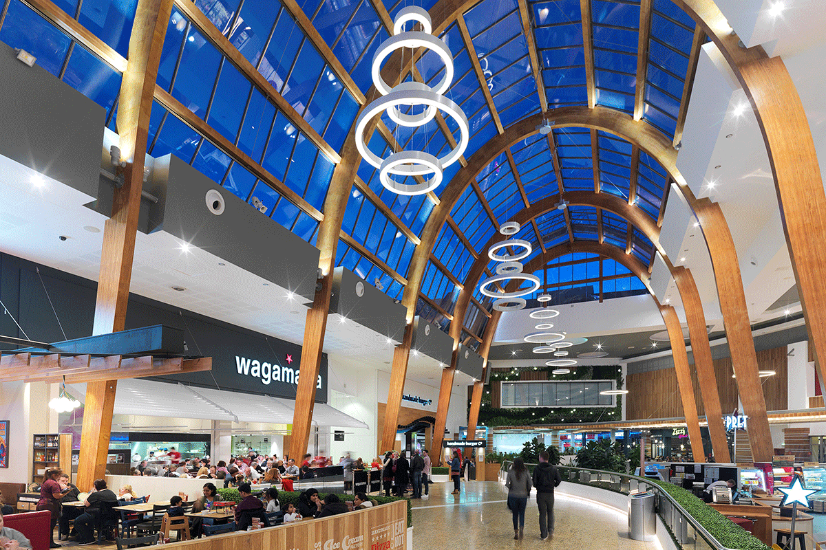
The arches in Silverburn Food Court are made from laminated timber, as shown above.

Slide 8
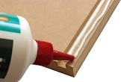
Gluing wood
The most common wood adhesive is PVA (polyvinyl acetate), which is a white glue that dries clear. It is non-toxic, non-flammable., water-based adhesive.
As it is water-based excess glue must be wiped away with a damp cloth or paper towel before it dries.
It is unsuitable for outdoor use and it’s best to leave the PVA for around 24 hours for it to dry.
Adhesives may be an option rather than screws as they provide a much stronger connection, looks more attractive as you don’t see screw heads and is a faster process as you don’t need to make holes

Slide 9
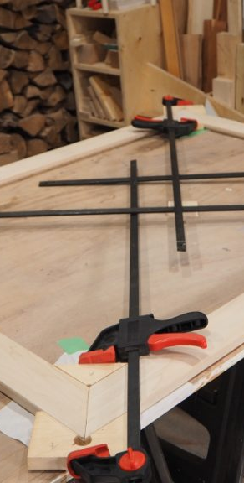
Checking squareness
Before any gluing of frames can be carried out, the frame must be assembled DRY. i.e. it needs to be checked to ensure that it is Square and is not affected by Winding (Twisting of the frame).
To check if the frame is square it is ideally done using long straight sticks to check the diagonals. See below. Another way to check for square would be to use a try square in the corner.

Slide 10

Checking squareness
Measuring Sticks
As can be seen from the drawing above, if a frame construction is Square, the diagonal distance (Corner to Corner) between each corner will be the same distance.
If the frame is not square the diagonal distance from corner to corner will be greater for one of the corners as shown above. This is corrected simply by adjusting the sash cramps until a satisfactory squareness is achieved.

Slide 11
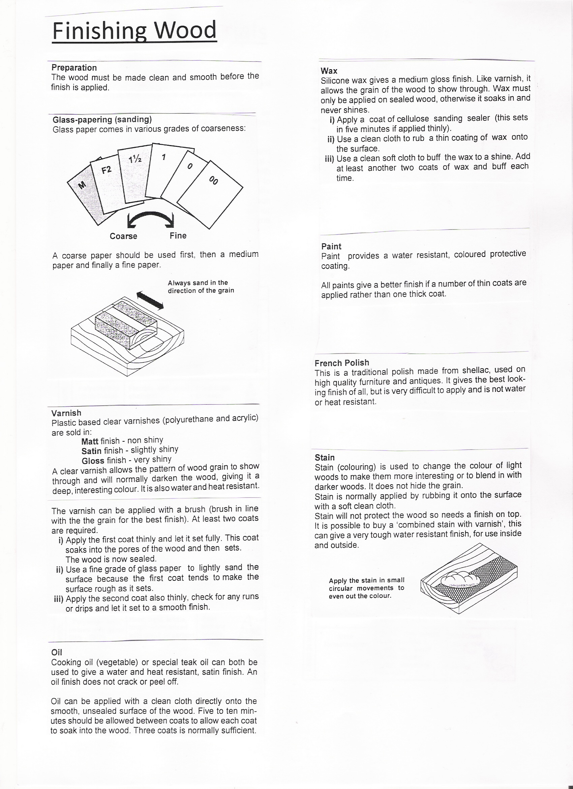
Applying a finish
Before applying a finish it is important to make sure that the surface is very smooth and free from blemishes (marks and scratches) by firstly using an appropriate plane or scraper and then different grades of abrasive paper/sand paper in the direction of the grain.
Sanding across the grain makes more scratches rather than making it smooth.
Always sand in the direction of the grain.

Slide 12
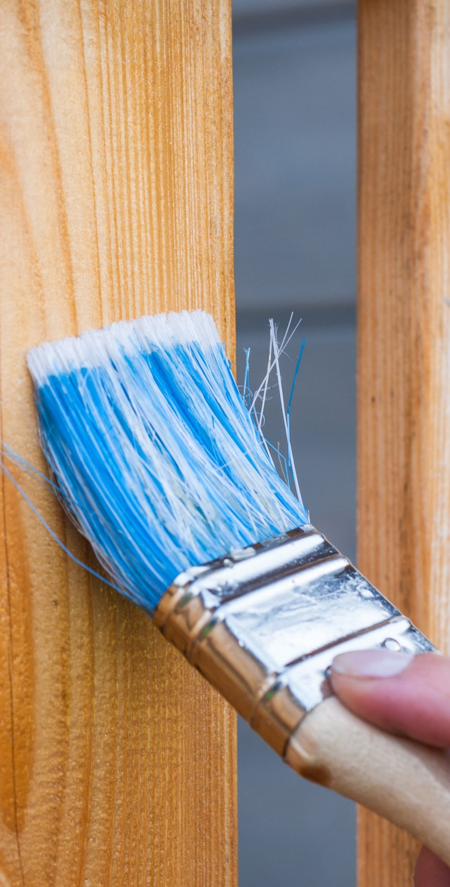
Sequence to applying varnish
The Smoothing Plane (Smaller brother of the Jack Plane) is used first to remove pencil lines and any major blemishes.
Next, use a Medium grade of sand paper sand all surfaces.
The next stage is to apply a fine sprinkle of water over the surface of the wood. This raises the grain in the wood which
when dry will be sanded off using a Fine Graded sand paper. This technique gives a better overall finish.
Using a Fine Graded sand paper sand down all surfaces.
Apply first coat of varnish. Allow to dry.
Using a Fine Graded sand paper sand down all surfaces.
Apply second coat of varnish. Allow to dry.

Slide 13
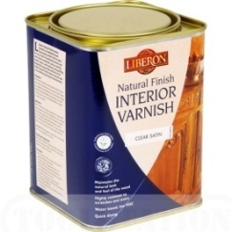
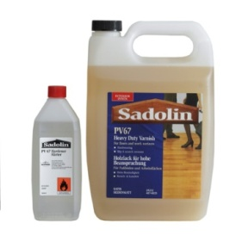
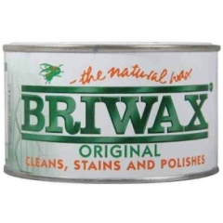
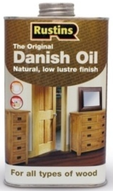
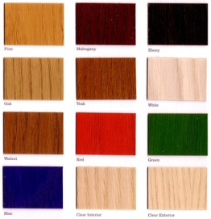
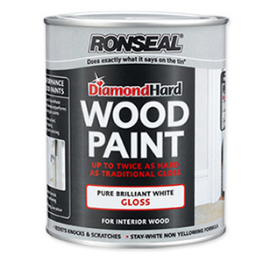
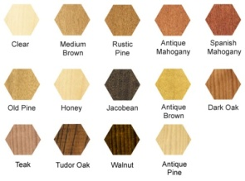
Types of finish
1.
2.
Water Based Varnish
Spirit Based Varnish
Wax Polish
Coloured Wax Polish
Danish Oil
Coloured Stains
Paints
3.
4.
5.
6.
7.

Slide 14
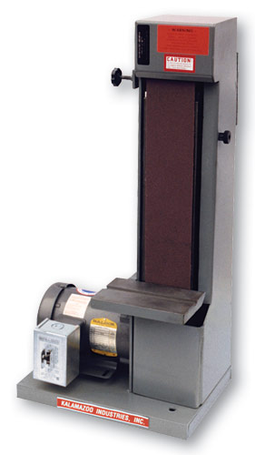
Belt sander
You will see these in the school’s workshops. They sand wood in a vertical motion.

Slide 15
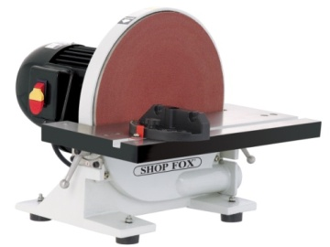
disc sander
These sand in a rotational motion.

Slide 16
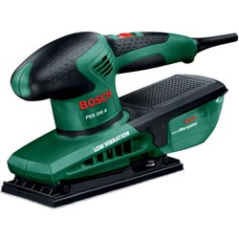
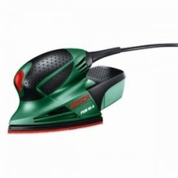
Hand held sanders
Hand held Orbital Sanders come in many shapes and sizes. Each have a dust extractor attached to them to stop the use breathing in excess dust. They sand by moving the sanding beds in small circular motions (orbital motions).

Slide 17
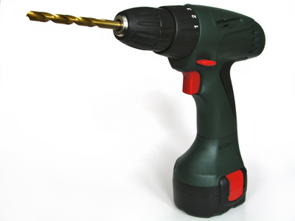
Cordless drill
This does the same as the bench and pillar drill, but because it is not attached to anything it can drill holes in more awkward areas.
This can also be used as an electric screwdriver if the drill bit is changed for a screw bit.

Slide 18
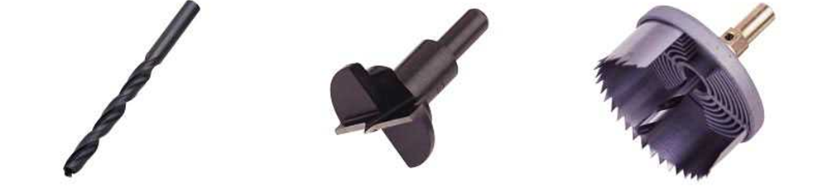
Drill bits
TWIST DRILL
Used for drilling holes. A normal drill set will include sizes from 1mm to 14mm.
FORSTNER BIT
Used for larger diameter holes. When using this bit the hole is drilled very slowly so that the bit does not ‘jam’ in the wood.
HOLE SAW
For large diameters a hole saw can be used. The advantage of this type of drill bit is that the blade can be changed to give different sizes of diameter.

Slide 19
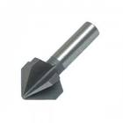
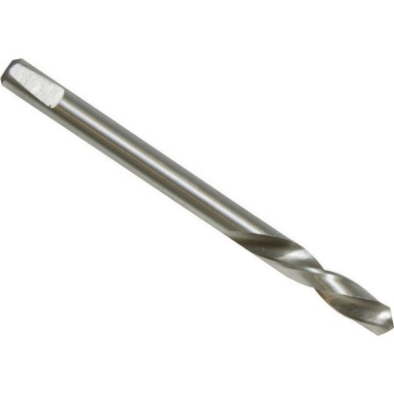
Drill bits 2
Pilot drill/hole
A small hole that will be drilled first.
Can be done so that a screw will be located in the wood, the wood won’t split, easier for a screw/bigger drill bit to go in, ensures alignment when countersunk.
Countersink hole
A countersink drill widens a drilled hole to allow a countersink screw to fit and be flush.
Countersink drills can also be used to remove a burr when drilling or tapping.

Slide 20
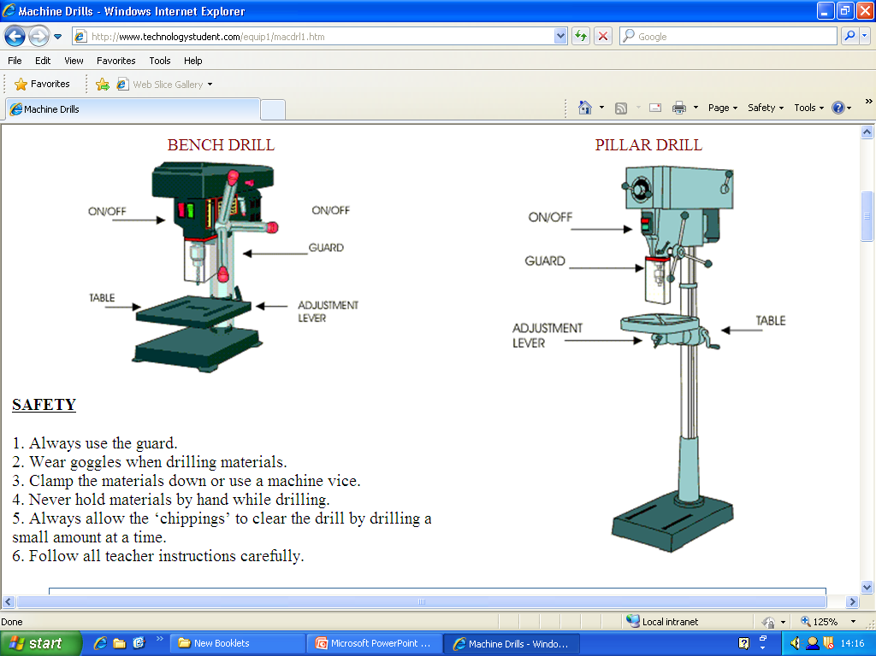
drills
Safety
Always use the guard.
Wear goggles when drilling materials.
Clamp the materials down or use a machine vice.
Never hold materials by hand while drilling.
Always allow the chippings to clear the drill by drilling a small amount at a time.
Follow all teacher instructions carefully.

Slide 21
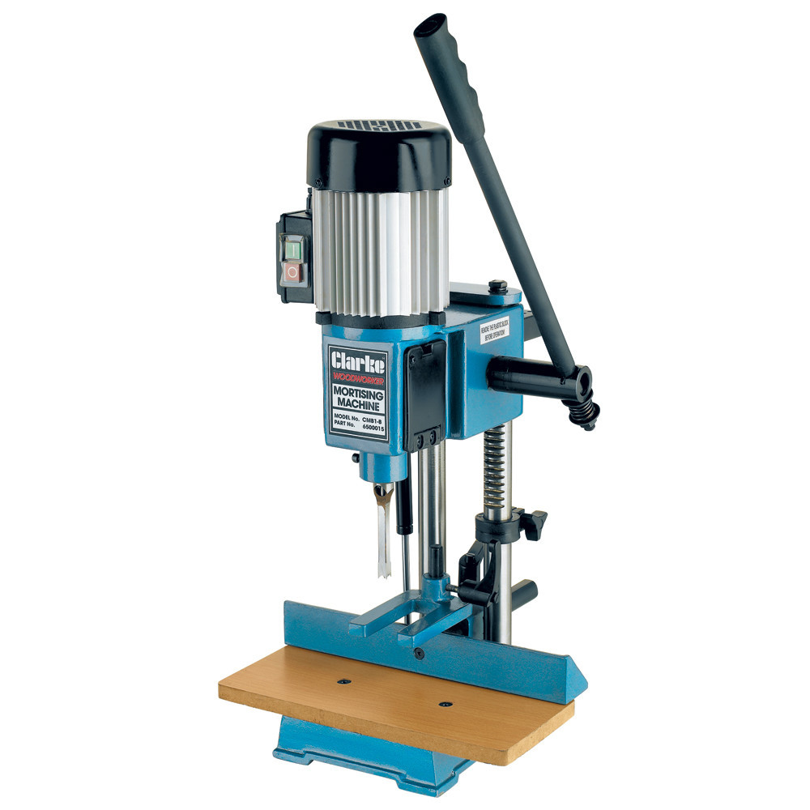
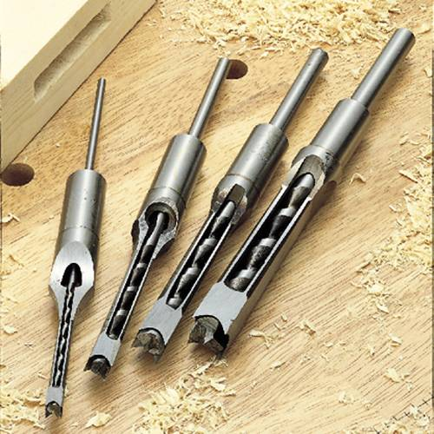
Mortise machine
A mortise machine can be used to help cut out the mortise in a Mortise and Tenon joint.
It uses a square chisel that contains a special twist drill to extract the waste wood.

Slide 22
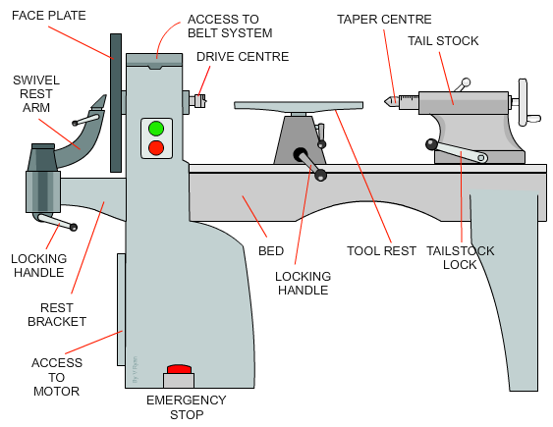
Woodturning lathe
A typical wood turning lathe is seen opposite. Wood turning takes place either at the face plate (bowls) or between the two centres, the drive centre and the tail stock centre.
For example, if a table leg is being turned, this is carried out between the two centres. However, if a bowl is being turned, the blank is usually screwed to the face plate

Slide 23
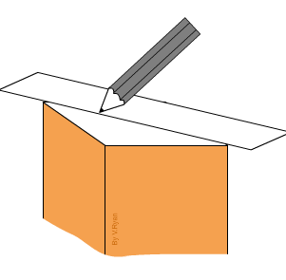
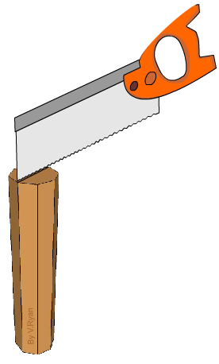
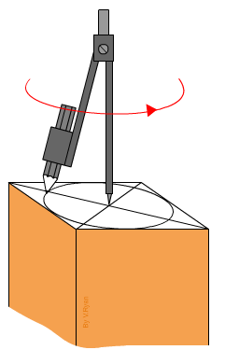
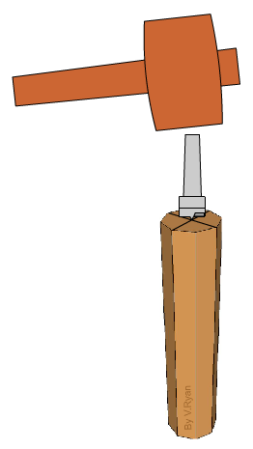
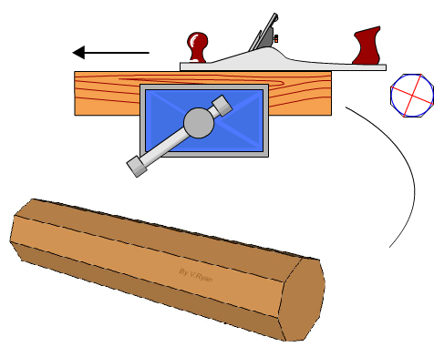
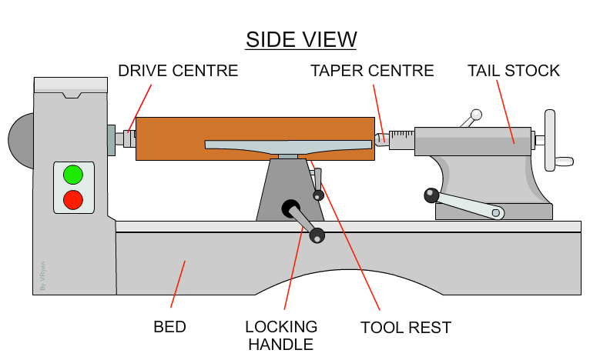
Preparing a length of wood for turning
1.
3.
Use tenon saw to cut a diagonal groove to one end of the piece of wood. This helps the centre prongs to grip the piece of wood
2.
4.
Using a compass, draw circle to mark in shape
The drive centre is hammered into position at the grooved end using a mallet
5.
6.
Remove waste wood using suitable plane

Slide 24
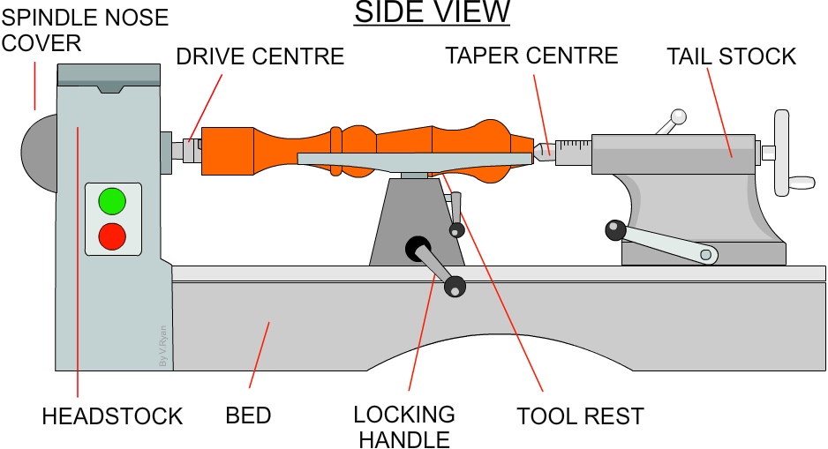
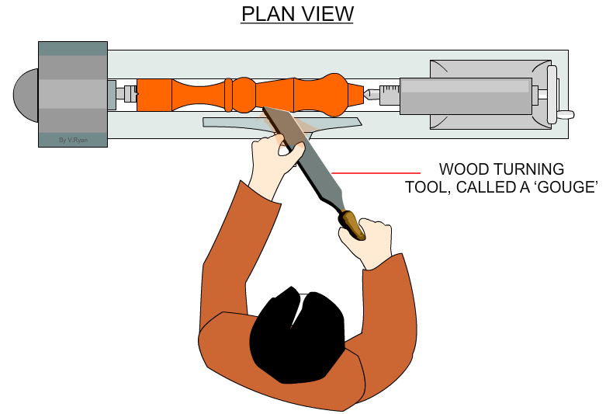
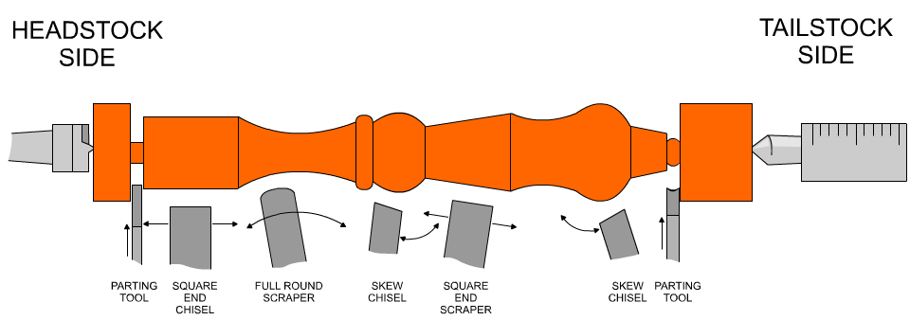
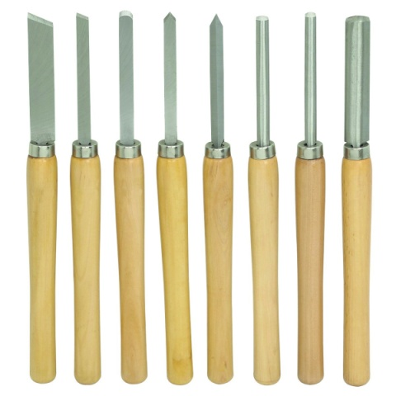
Turning between centres
As the wood spins between the centres the person using the lathe will create a design on the wood by using different types of chisel at different pressures.

Slide 25
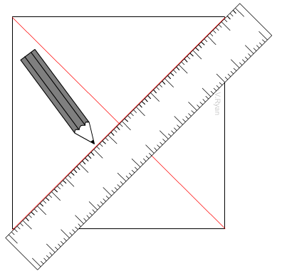
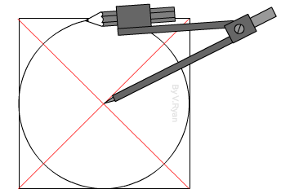
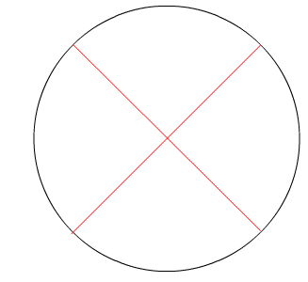
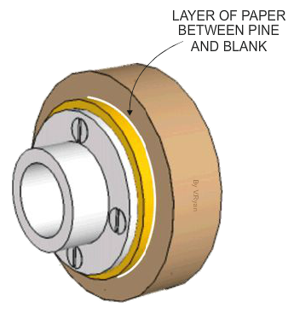
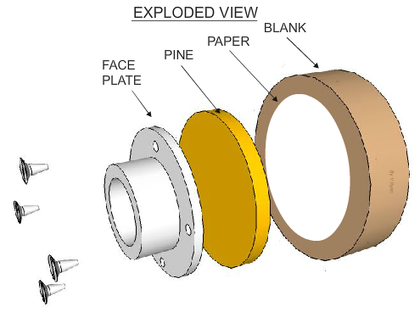
Preparing a wooden blank for bowl turning
The blank must not have obvious splits, cracks or any weaknesses which can shatter when blank is revolving at high speeds. Remove corners of blanks, as it is very dangerous to turn a square shaped section on a lathe.
A circle is drawn with its centre at the crossing diagonal lines
A bandsaw is used to remove the waste and the corners, ready for turning in the lathe
FIXING BOWL BLANK TO LATHE
Fix pine (pine plate takes the screw holes, as opposed to screw holes left in bottom of bowl blank) backing to face plate,
Affix paper to pine and to bowl blank with either suitable adhesive, or strong double sided tape

Slide 26
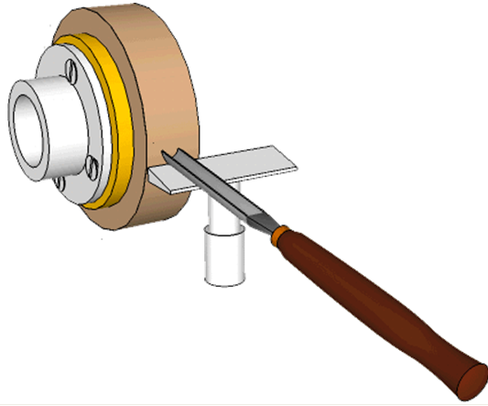
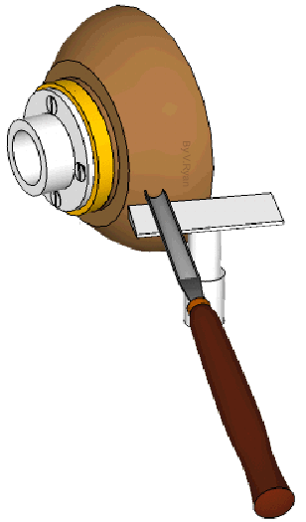
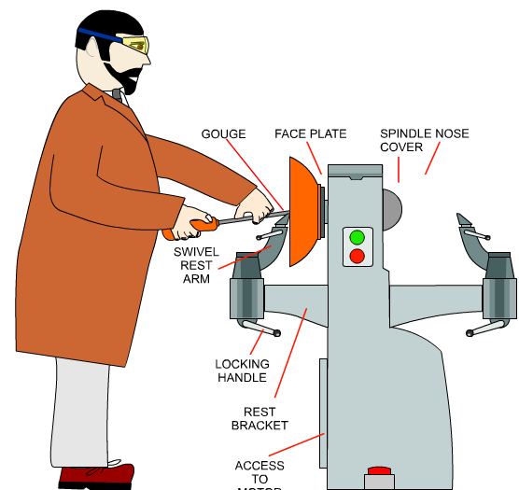


Turning a bowl
Using suitable chisel, smooth out and centre blank ready for shaping
Shape outside of
bowl to desired shape, using suitable selection of chisels
Smooth both inside and outside of bowl using different grades of sandpaper to achieve smooth surface – finish with oil or other polishes
Shape inside of
bowl to desired shape, using suitable selection of chisels

Slide 27

Sustainable forest lifecycle
The forest is a working environment, producing wood products such as wood pulp for the paper / card industry and wood based materials for furniture manufacture and the construction industry. Great care is taken to ensure the safety of wildlife and to preserve the natural environment.
Sustainable forests are the result of a commonsense policy to replace trees that are felled so that forests continue to exist providing natural materials for us all.

